Slide 1
Team collaboration and best practices
Collaboration simply means to work jointly rather than independently to accomplish a task.
Agile methodologies stress the benefits of working with cross-functional teams to encourage strong communication between business owners, from whom we get requirements for products, and the technical team that produces the product.
Collaboration is also very important between members of the technical team. Rather than working in functional
Agile methodologies promote frequent and face-to-face communication between all team members

Slide 2
Communication
There are many tools and processes that leaders can use to foster strong collaboration on their teams. Regardless of software methodology being used, any team will benefit from helping foster an environment of healthy communication and collaboration

Slide 3
Web application testing Practices:
Remove browser cookies
Remove browser cache
Remove previous history
Test in incognito mode
Change security setting of the browser
Emphasis on Cross-Browser Compatibility Testing
Evaluate the Application’s Performance Under Various Conditions
Choose the Right Parameters for Usability Testing
Validate all Security Issues with Security Testing
Integrate Exploratory Testing in the Software Development Lifecycle

Slide 4
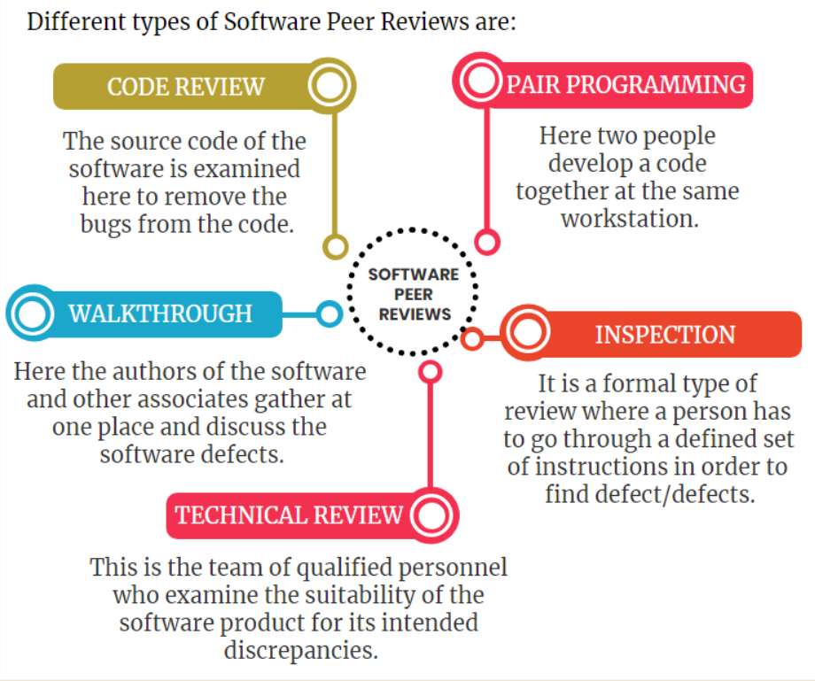
Types of Reviews in Software Testing

